Slide 1
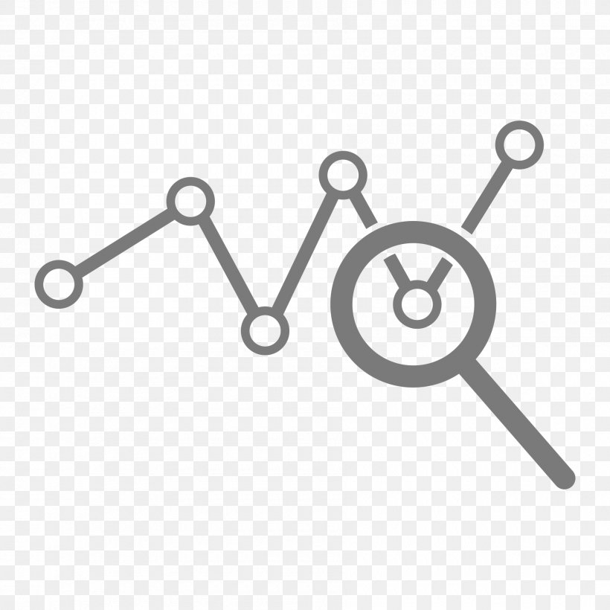




Wearable Devices and Computer Vision
Wednesday, July 1, 2020
Head Instructor: Jose Luis Ramirez Herran
TA’s: Souleymane Konate and Ricardo Villamil

Slide 2
Summary from past two weeks
Students are getting the hardware
Get started with the Sensor Tile development
Introduce the basic signal processing concepts
Introduce image processing – basic image operations

Slide 3

Today’s Lecture
Break
7:40 pm – 7:50 pm
Break
8:40 pm – 8:50 pm
Part 1
Tutorial 1 Troubleshooting page
Part 2
Linear and Logistic Regression using Python
Questions
Part 3
Homework
Questions?
Projects and Teams
Logistics
Intro to ML and Human Activity Recognition
6:30 pm – 7:30 pm
7:50 pm – 8:40 pm
8:50 pm – 9:30 pm

Slide 4

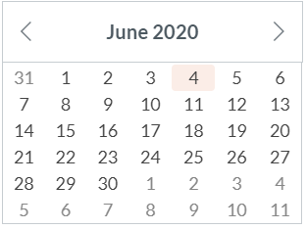
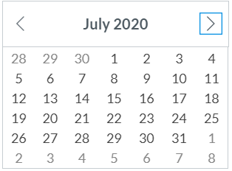
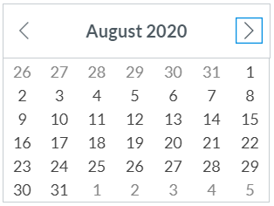
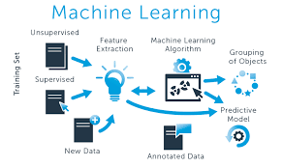

Calendar summer 2020
Mondays and Wednesdays 6:30 pm – 9:30 pm
Wearable Devices and Computer Vision
Project
presentations
Su M Tu W Th F S
SW+HW Setup.+ Basic Tutorials

Slide 5
Reminders
If you haven’t done so already, please take a couple of seconds and submit your location now in Canvas.
Please sign-up for piazza now.
Piazza2020Summer_Access_Codes:
Wearables code:
dgmds1434484
Class Signup Link:
piazza.com/extension.harvard/summer2020/dgmds1434484
Thanks

Slide 6
Office hours
Jose Luis Ramirez Herran
Calendly link:
Souleymane Konate
Calendly link:
Ricardo Villamil
Calendly link:

Slide 7
Office hours
emails TA's:
sok462@g.harvard.edu
ricardo_villamil@fas.harvard.edu
Calendly me:
https://calendly.com/jlr682/wearable-devices-final-project

Slide 8
Bonus materials: Videos from summer 2019
As an excellent resource we will provide this year is the access to the Lectures from the summer of 2019.
During that semester, we focused a lot in the details about the software and the tutorials.
The video module is an excellent resource that could help you to answers many questions while you are experimenting with the machine learning embedded system: Sensor Tile. You can do this learning independently at your own pace in your own time-zone.

Slide 9
Troubleshooting tutorials in canvas
We have very effective office hours so far and we can show some videos were we solved specific problems related with the tutorials. Please take a look in Canvas and we hope this videos help you to get started with the sensorTile curriculum. They will be published into the canvas modules.

Slide 10
Break
7:30 pm – 7:40 pm
6:30 pm – 7:30 pm
Part 1
Logistics
Tutorial 1 Troubleshooting page
Intro to ML and Human Activity Recognition

Slide 11
Part 1 introduction to ML
June 29, 2020

Slide 12
Introduction to Machine Learning using Python ML Libraries.
The objective is not to go into deep discussions but make the subject easy to understand, get some practical applications and motivate you to learn further
We will go deeper into this concepts next week.
We will walk through multiple code examples using jupyter notebooks to show how this algorithms work in practice

Slide 13
Introduction to artificial intelligence, machine learning, and deep learning.
Artificial Intelligence
Deep Learning
Machine Learning
Artificial Intelligence: a way to make machines think and behave “intelligently”.
Machine Learning: is a collection of algorithms and techniques used to design systems that learn from data.
Deep Learning: refers to training Neural Networks, sometimes very large Neural Networks.
Regression
Classification
Clustering
References: Joshi, P. (2017). Artificial intelligence with Python Birmingham: Packt. Python Machine Learning, Wei-Ming Lee. Andrew Ng Coursera AI course.

Slide 14
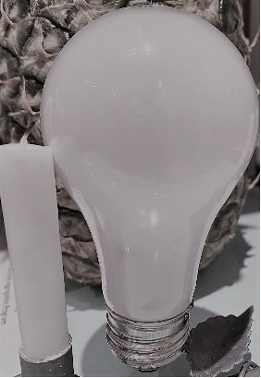
Artificial intelligence, ML, DL, and applications
AI
100 years ago, the electrification of our society transformed every major industry, every ranging from transportation, manufacturing, to healthcare, to communications and many more. And today, we see a surprisingly clear path for AI to bring about an equally big transformation. And of course, the part of AI that is rising rapidly and driving a lot of these developments, is deep learning.
Andrew Ng

Slide 15
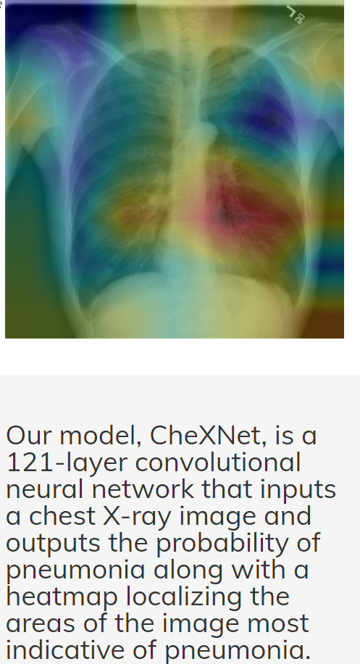
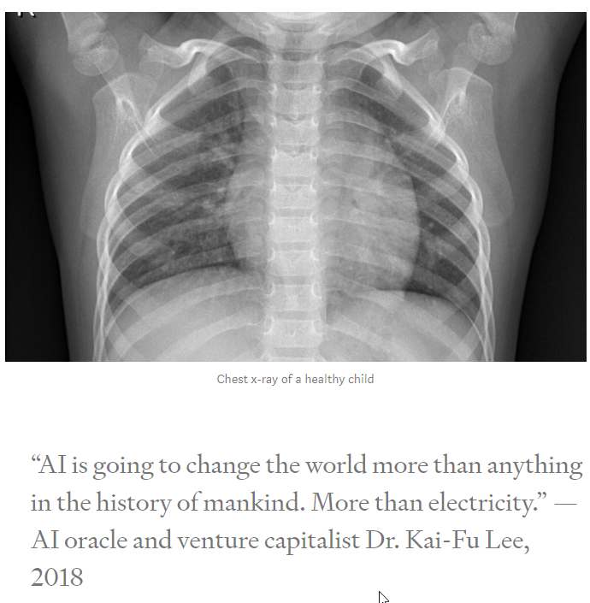
detect pneumonia from chest X-rays at a level exceeding practicing radiologists
https://stanfordmlgroup.github.io/projects/chexnet/

Slide 16
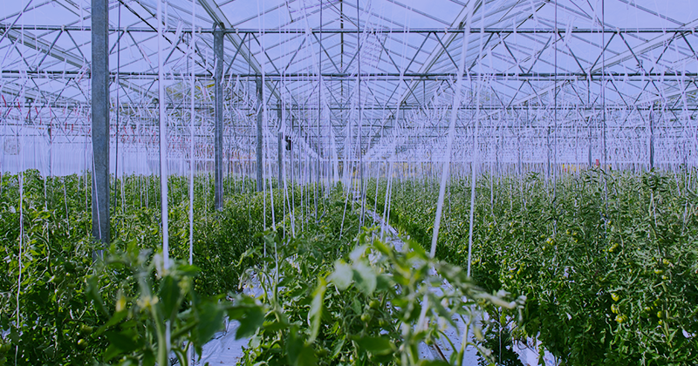
Machine Learning in Agriculture: Applications and Techniques
Species management
Field conditions management
Livestock management
Etc.
https://medium.com/sciforce/machine-learning-in-agriculture-applications-and-techniques-6ab501f4d1b5

Slide 17
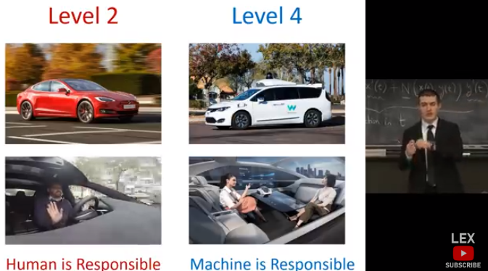
Autonomous Car
Supervision and Responsibility of the AI system
Level 2: Human
Level4 : Machine
Leaders on Testing:
Waymo
Dessier
Others:
Tesla
Google
Etc.
https://selfdrivingcars.mit.edu/

Slide 18
The basics of machine learning
Python libraries
Basic Machine Learning Algorithms
Supervised Learning
Linear Regression
Classification
Using logistic Regression
Using Support Vector Machines
Using K-Nearest Neighbors (KNN)
Unsupervised Learning
Clustering using K-means
1. Numpy
2. Pandas
3. Mathplotlib
4. Scikit-learn

Slide 19
Requirements
Install
Anaconda Environment Python 3.7
Numpy
Pandas
Matplotlib
Scikit-learn

Slide 20
What is machine learning
Traditional
Programming
Machine Learning
Computer
Data
Program
Computer
Data
Output
Program
Output
Write a program, feed data, get output
Use data and the output to derive your
program (known as the model

Slide 21
machine learning – simple example
Traditional desktop/web programming
Write a program to perform accounting tasks using your sales records, inventory lists, etc. the output will be the profit/loss statement.
Machine Learning
Instead of feeding the data to a program, we use the data (the sales records and the output) to derive rules to make predictions. You may use this model (program) to predict the most popular items that will sell, or which items will be less popular the next year.

Slide 22
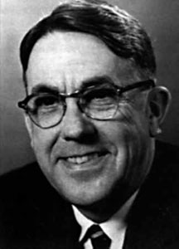
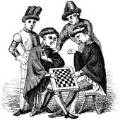
ML Definition
In 1959, Arthur Samuel defined machine learning as a "field of study that gives computers the ability to learn without being explicitly programmed“. Machine learning explores the study and construction of algorithms that can learn from and make predictions on data. Such algorithms operate by building a model from an example training set of input observations in order to make data-driven predictions or decisions expressed as outputs, rather than following strictly static program instructions.
https://en.wikipedia.org/wiki/Outline_of_machine_learning#Machine_learning_algorithms

Slide 23
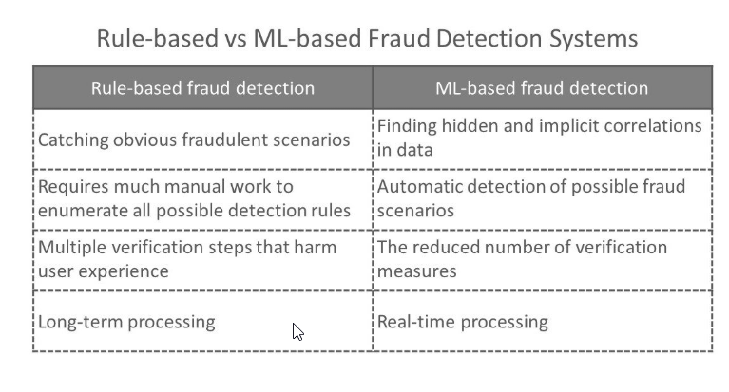
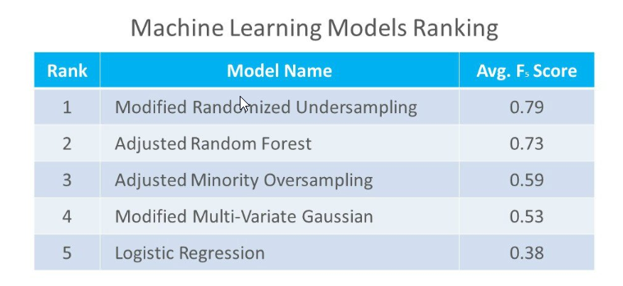
Interesting case
Study Subtle and hidden events in user behavior that may not be evident, but still signal possible fraud. Machine learning allows for creating algorithms that process large datasets with many variables and help find these hidden correlations between user behavior and the likelihood of fraudulent actions. Another strength of machine learning systems compared to rule-based ones is faster data processing and less manual work. For example, smart algorithms fit well with behavior analytics for helping reduce the number of verification steps
The user of ML needs to know which method
of ML will best help completing the task and
how to apply it. Not necessarily needs to know
how those methods works, but this will always
help in building a more accurate model.
https://www.altexsoft.com/whitepapers/fraud-detection-how-machine-learning-systems-help-reveal-scams-in-fintech-healthcare-and-ecommerce/

Slide 24
Examples of problems we can solve with ml
Classification
ED triage systems that accurately differentiate and prioritise critically ill from stable patients
Classifying types of flowers
Regression
Predicting the temperatures for next week
Predicting statistics performance, based on math aptitude scores
Clustering
It can be used for classification among different species of plants and animal
Break up the image into meaningful or perceptually similar regions
Image classifier Cats vs Dogs
Spam Detection
Logistic Regression classifier may be used to identify whether a tumour is malignant or if it is benign.
Cluster news articles
Clustering species (“phylogeny”)
dataset which contains information about relationship between ‘number of hours studied’ and ‘marks obtained’.if we give number of hours studied by a student as an input, our model should predict their mark with minimum error
https://healthmanagement.org/c/icu/news/harvard-study-machine-learning-improves-ed-triage
(in medical use) the assignment of degrees of urgency to wounds or illnesses to decide the order of treatment of a large number of patients or casualties

Slide 25

Classification
In ML, classification is identifying to which category or class a new observation belongs based on the set of training data. According with the number of categories, a classification problem can be called two-class classification problem if it has two classes or multi-class classification problem if it has more than two.
The outcome of a classification problem is a discrete value indicating the predicted class to which the new observation belong to, and can also be a continuous value indicating the likelihood of an observation belonging to a particular class.

Slide 26
Multiclass Classification with Imbalanced Dataset
Classification problems having multiple classes with imbalanced dataset present a different challenge than a binary classification problem. The skewed distribution makes many conventional machine learning algorithms less effective, especially in predicting minority class examples
https://towardsdatascience.com/machine-learning-multiclass-classification-with-imbalanced-data-set-29f6a177c1a

Slide 27
Multiclass Classification
A classification task with more than two classes; e.g., classify a set of images of fruits which may be oranges, apples, or pears. Multi-class classification makes the assumption that each sample is assigned to one and only one label: a fruit can be either an apple or a pear but not both at the same time.

Slide 28
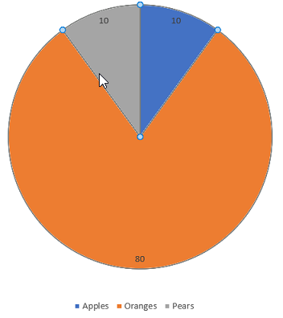
Imbalanced Dataset
Imbalanced data typically refers to a problem with classification problems where the classes are not represented equally.
For example, you may have a 3-class classification problem of set of fruits to classify as oranges, apples or pears with total 100 instances .
A total of 80 instances are labeled with Class-1 (Oranges), 10 instances with Class-2 (Apples) and the remaining 10 instances are labeled with Class-3 (Pears).
This is an imbalanced dataset and the ratio of 8:1:1. Most classification data sets do not have exactly equal number of instances in each class, but a small difference often does not matter.

Slide 29
Imbalanced Dataset
There are problems where a class imbalance is not just common, it is expected. For example, in datasets like those that characterize fraudulent transactions are imbalanced. The vast majority of the transactions will be in the “Not-Fraud” class and a very small minority will be in the “Fraud” class.

Slide 30
How to improve the performance?
There are various techniques involved in improving the performance of imbalanced datasets. Looking at the confusion matrix one can clearly see how the model is performing on classifying various classes.
Re-sampling Dataset
To make our dataset balanced there are two ways to do so:
Under-sampling: Remove samples from over-represented classes ; use this if you have huge dataset
Over-sampling: Add more samples from under-represented classes; use this if you have small dataset

Slide 31
Other ways to improve the performance?
SMOTE (Synthetic Minority Over-sampling Technique)
SMOTE is an over-sampling method. It creates synthetic samples of the minority class. We use imblearn python package to over-sample the minority classes .
Precision-Recall Curves
Precision-Recall is a useful measure of success of prediction when the classes are very imbalanced. Precision is a measure of the ability of a classification model to identify only the relevant data points, while recall is a measure of the ability of a model to find all the relevant cases within a dataset.
https://towardsdatascience.com/machine-learning-multiclass-classification-with-imbalanced-data-set-29f6a177c1a
https://github.com/javaidnabi31/Multi-class-with-imbalanced-dataset-classification/blob/master/20-news-group-classification.ipynb

Slide 32
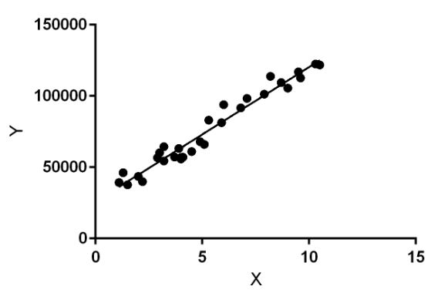
regression
Regression helps in predicting the future by estimating the relationship between variables. Regression returns not a category (a discrete value) but a continuous output variable.
It performs a regression task. Regression models a target prediction value based on independent variables. It is mostly used for finding out the relationship between variables and forecasting. Different regression models differ based on – the kind of relationship between dependent and independent variables, they are considering and the number of independent variables being used.
https://www.geeksforgeeks.org/ml-linear-regression/

Slide 33
ML | Linear Regression
Linear regression performs the task to predict a dependent variable value (y) based on a given independent variable (x). So, this regression technique finds out a linear relationship between x (input) and y(output). Hence, the name is Linear Regression. In the figure above, X (input) is the work experience and Y (output) is the salary of a person. The regression line is the best fit line for our model.
Computer
Data(x)
Output(y)
Program
Y = mx +b
Output (Y): Salary of a person
Use data and the output to derive your
program (known as the model
X: number of rooms
Y: price of house
Input (X): Work Experience

Slide 34
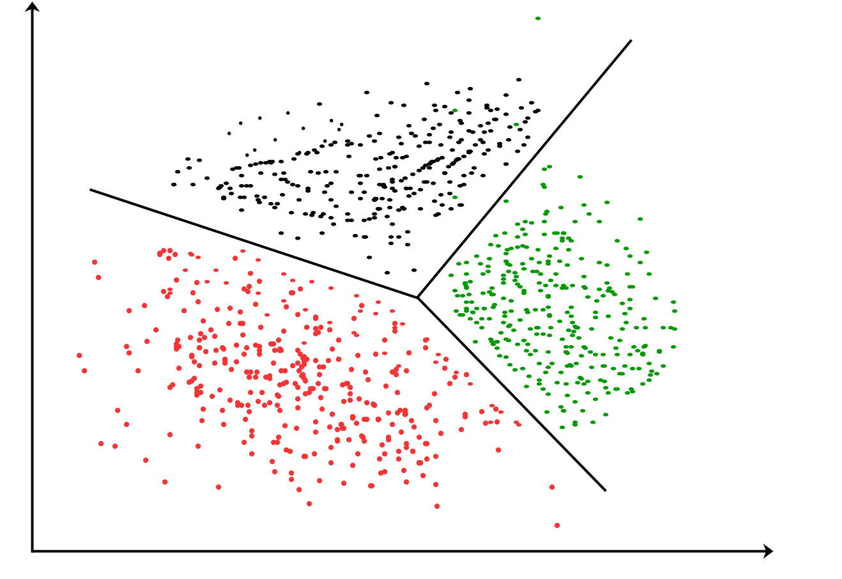
clustering
Clustering is the task of dividing the population or data points into a number of groups such that data points in the same groups are more similar to other data points in the same group and dissimilar to the data points in other groups. It is basically a collection of objects on the basis of similarity and dissimilarity between them.
https://www.geeksforgeeks.org/clustering-in-machine-learning/

Slide 35
Types of machine learning algorithms
Supervised Learning Algorithms
Are trained with labeled data. Data composed of examples of the desired answers. Using the label, unlabeled data can be predicted to obtain a new label.
Unsupervised Learning Algorithms
Are used on data with no labels, and the goal is to find relationships in the data.

Slide 36
Types of machine learning algorithms
Supervised Learning Algorithms
Are trained with labeled data. Data composed of examples of the desired answers. Using the label, unlabeled data can be predicted to obtain a new label.
Unsupervised Learning Algorithms
Are used on data with no labels, and the goal is to find relationships in the data.

Slide 37
Supervised and Unsupervised learning
Supervised learning is the Data mining task of inferring a function from labeled training data. The training data consist of a set of training examples. In supervised learning, each example is a pair consisting of an input object (typically a vector) and a desired output value (also called the supervisory signal). A supervised learning algorithm analyzes the training data and produces an inferred function, which can be used for mapping new examples. An optimal scenario will allow for the algorithm to correctly determine the class labels for unseen instances. This requires the learning algorithm to generalize from the training data to unseen situations in a “reasonable” way.
Unsupervised Learning
In Data mining, the problem of unsupervised learning is that of trying to find hidden structure in unlabeled data. Since the examples given to the learner are unlabeled, there is no error or reward signal to evaluate a potential solution.
https://dataaspirant.wordpress.com/2014/09/19/supervised-and-unsupervised-learning/

Slide 38
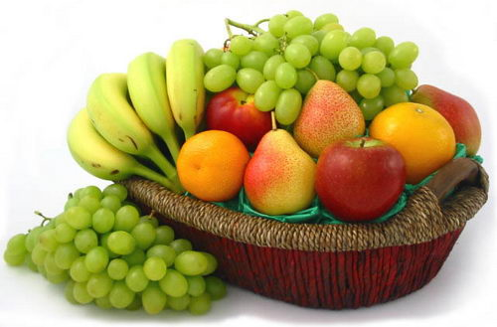
learn supervised and unsupervised learning with an real life example
Suppose you have a basket and it is filled with different kinds of fruits.
Your task is to arrange them as groups.
For understanding let me clear the names of the fruits in our basket.
APPLE
BANANA
GRAPE
CHERRY

Slide 39
Supervised Learning :
You already learn from your previous work about the physical characters of fruits
So arranging the same type of fruits at one place is easy now
Your previous work is called as training data in data mining
You already learn the things from your train data, this is because of response variable
Response variable means just a decision variable
You can observe response variable below (FRUIT NAME)

Slide 40
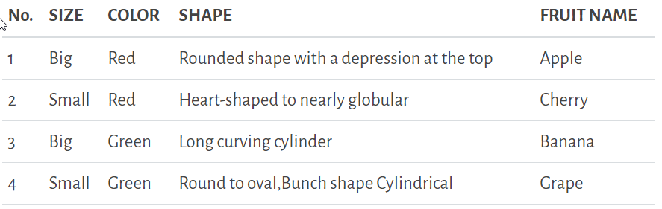
Supervised Learning :
Suppose you have taken a new fruit from the basket then you will see the size , color and shape of that particular fruit. If size is Big , color is Red , shape is rounded shape with a depression at the top, you will conform the fruit name as apple and you will put in apple group.
Likewise for other fruits also.
Job of grouping fruits was done and happy ending.
You can observe in the table that a column was labeled as “FRUIT NAME“. This is called as response variable.
If you learn the thing before from training data and then applying that knowledge to the test data(for new fruit), This type of learning is called as Supervised Learning.
Classification comes under Supervised learning.

Slide 41
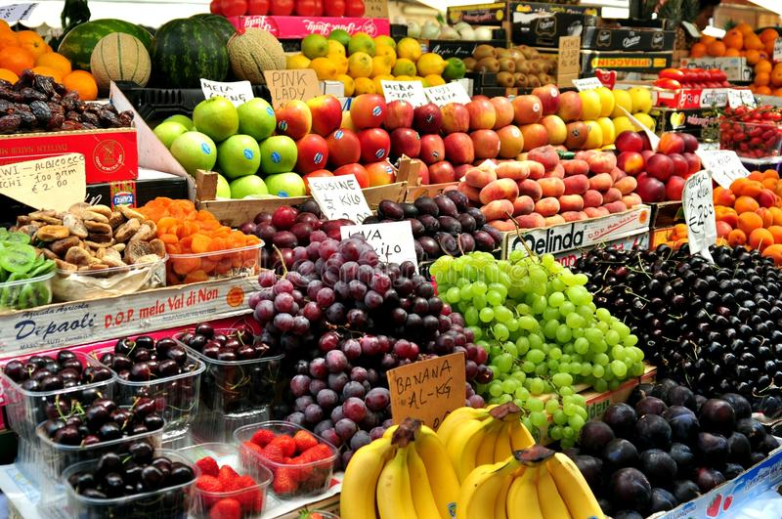
Unsupervised Learning :

Slide 42
Unsupervised Learning :
Suppose you have a basket and it is filled with some different types fruits, your task is to arrange them as groups.
This time you don’t know any thing about the fruits, honestly saying this is the first time you have seen them. You have no clue about those.
So, how will you arrange them?
What will you do first???
You will take a fruit and you will arrange them by considering physical character of that particular fruit.
Suppose you have considered color.
Then you will arrange them on considering base condition as color.
Then the groups will be some thing like this.
RED COLOR GROUP: apples & cherry fruits.
GREEN COLOR GROUP: bananas & grapes.
So now you will take another physical character such as size .
RED COLOR AND BIG SIZE: apple.
RED COLOR AND SMALL SIZE: cherry fruits.
GREEN COLOR AND BIG SIZE: bananas.
GREEN COLOR AND SMALL SIZE: grapes.
Job done happy ending.
Here you did not learn anything before ,means no train data and no response variable.
This type of learning is known as unsupervised learning.
Clustering comes under unsupervised learning.

Slide 43
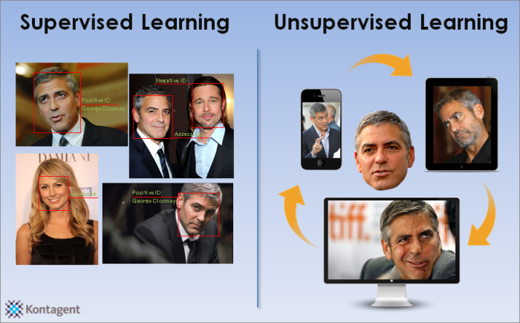
Supervised and unsupervised learning
Supervised learning classified into two categories of algorithms:
Classification: A classification problem is when the output variable is a category, such as “Red” or “blue” or “disease” and “no disease”.
Regression: A regression problem is when the output variable is a real value, such as “dollars” or “weight”.
Unsupervised learning classified into two categories of algorithms:
Clustering: A clustering problem is where you want to discover the inherent groupings in the data, such as grouping customers by purchasing behavior.
Association: An association rule learning problem is where you want to discover rules that describe large portions of your data, such as people that buy X also tend to buy Y.

Slide 44
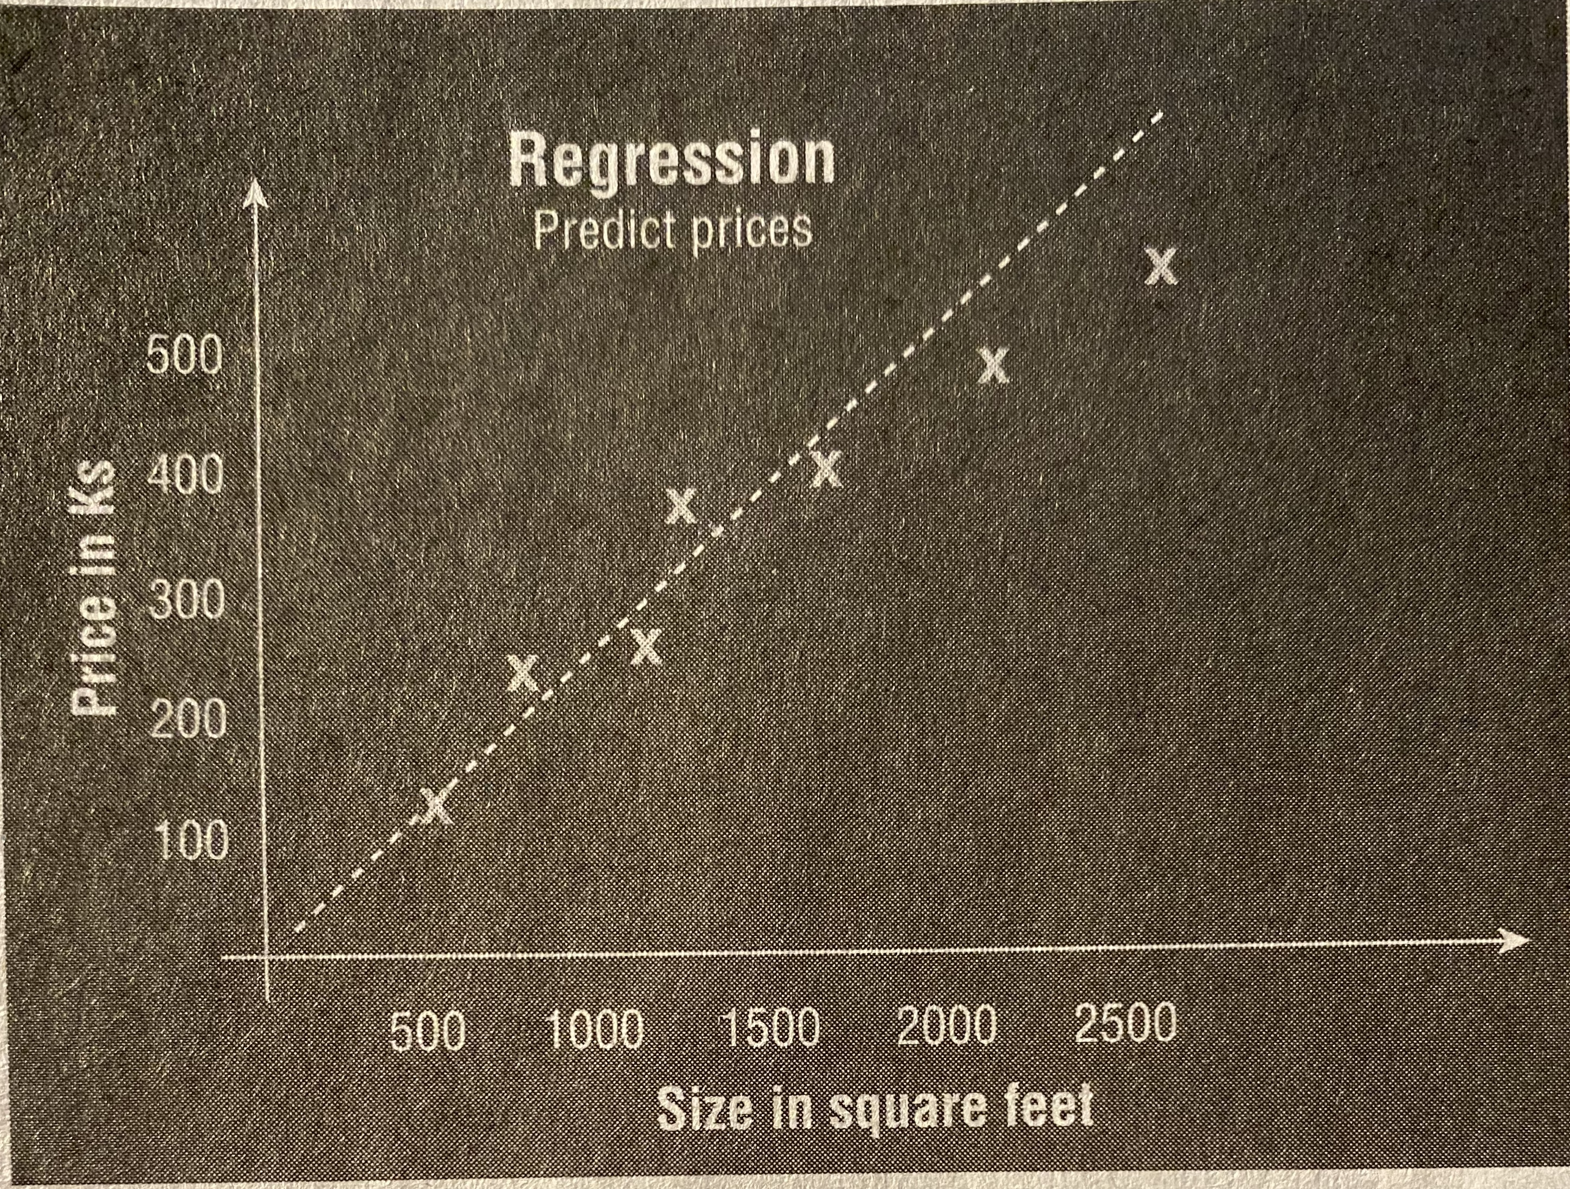
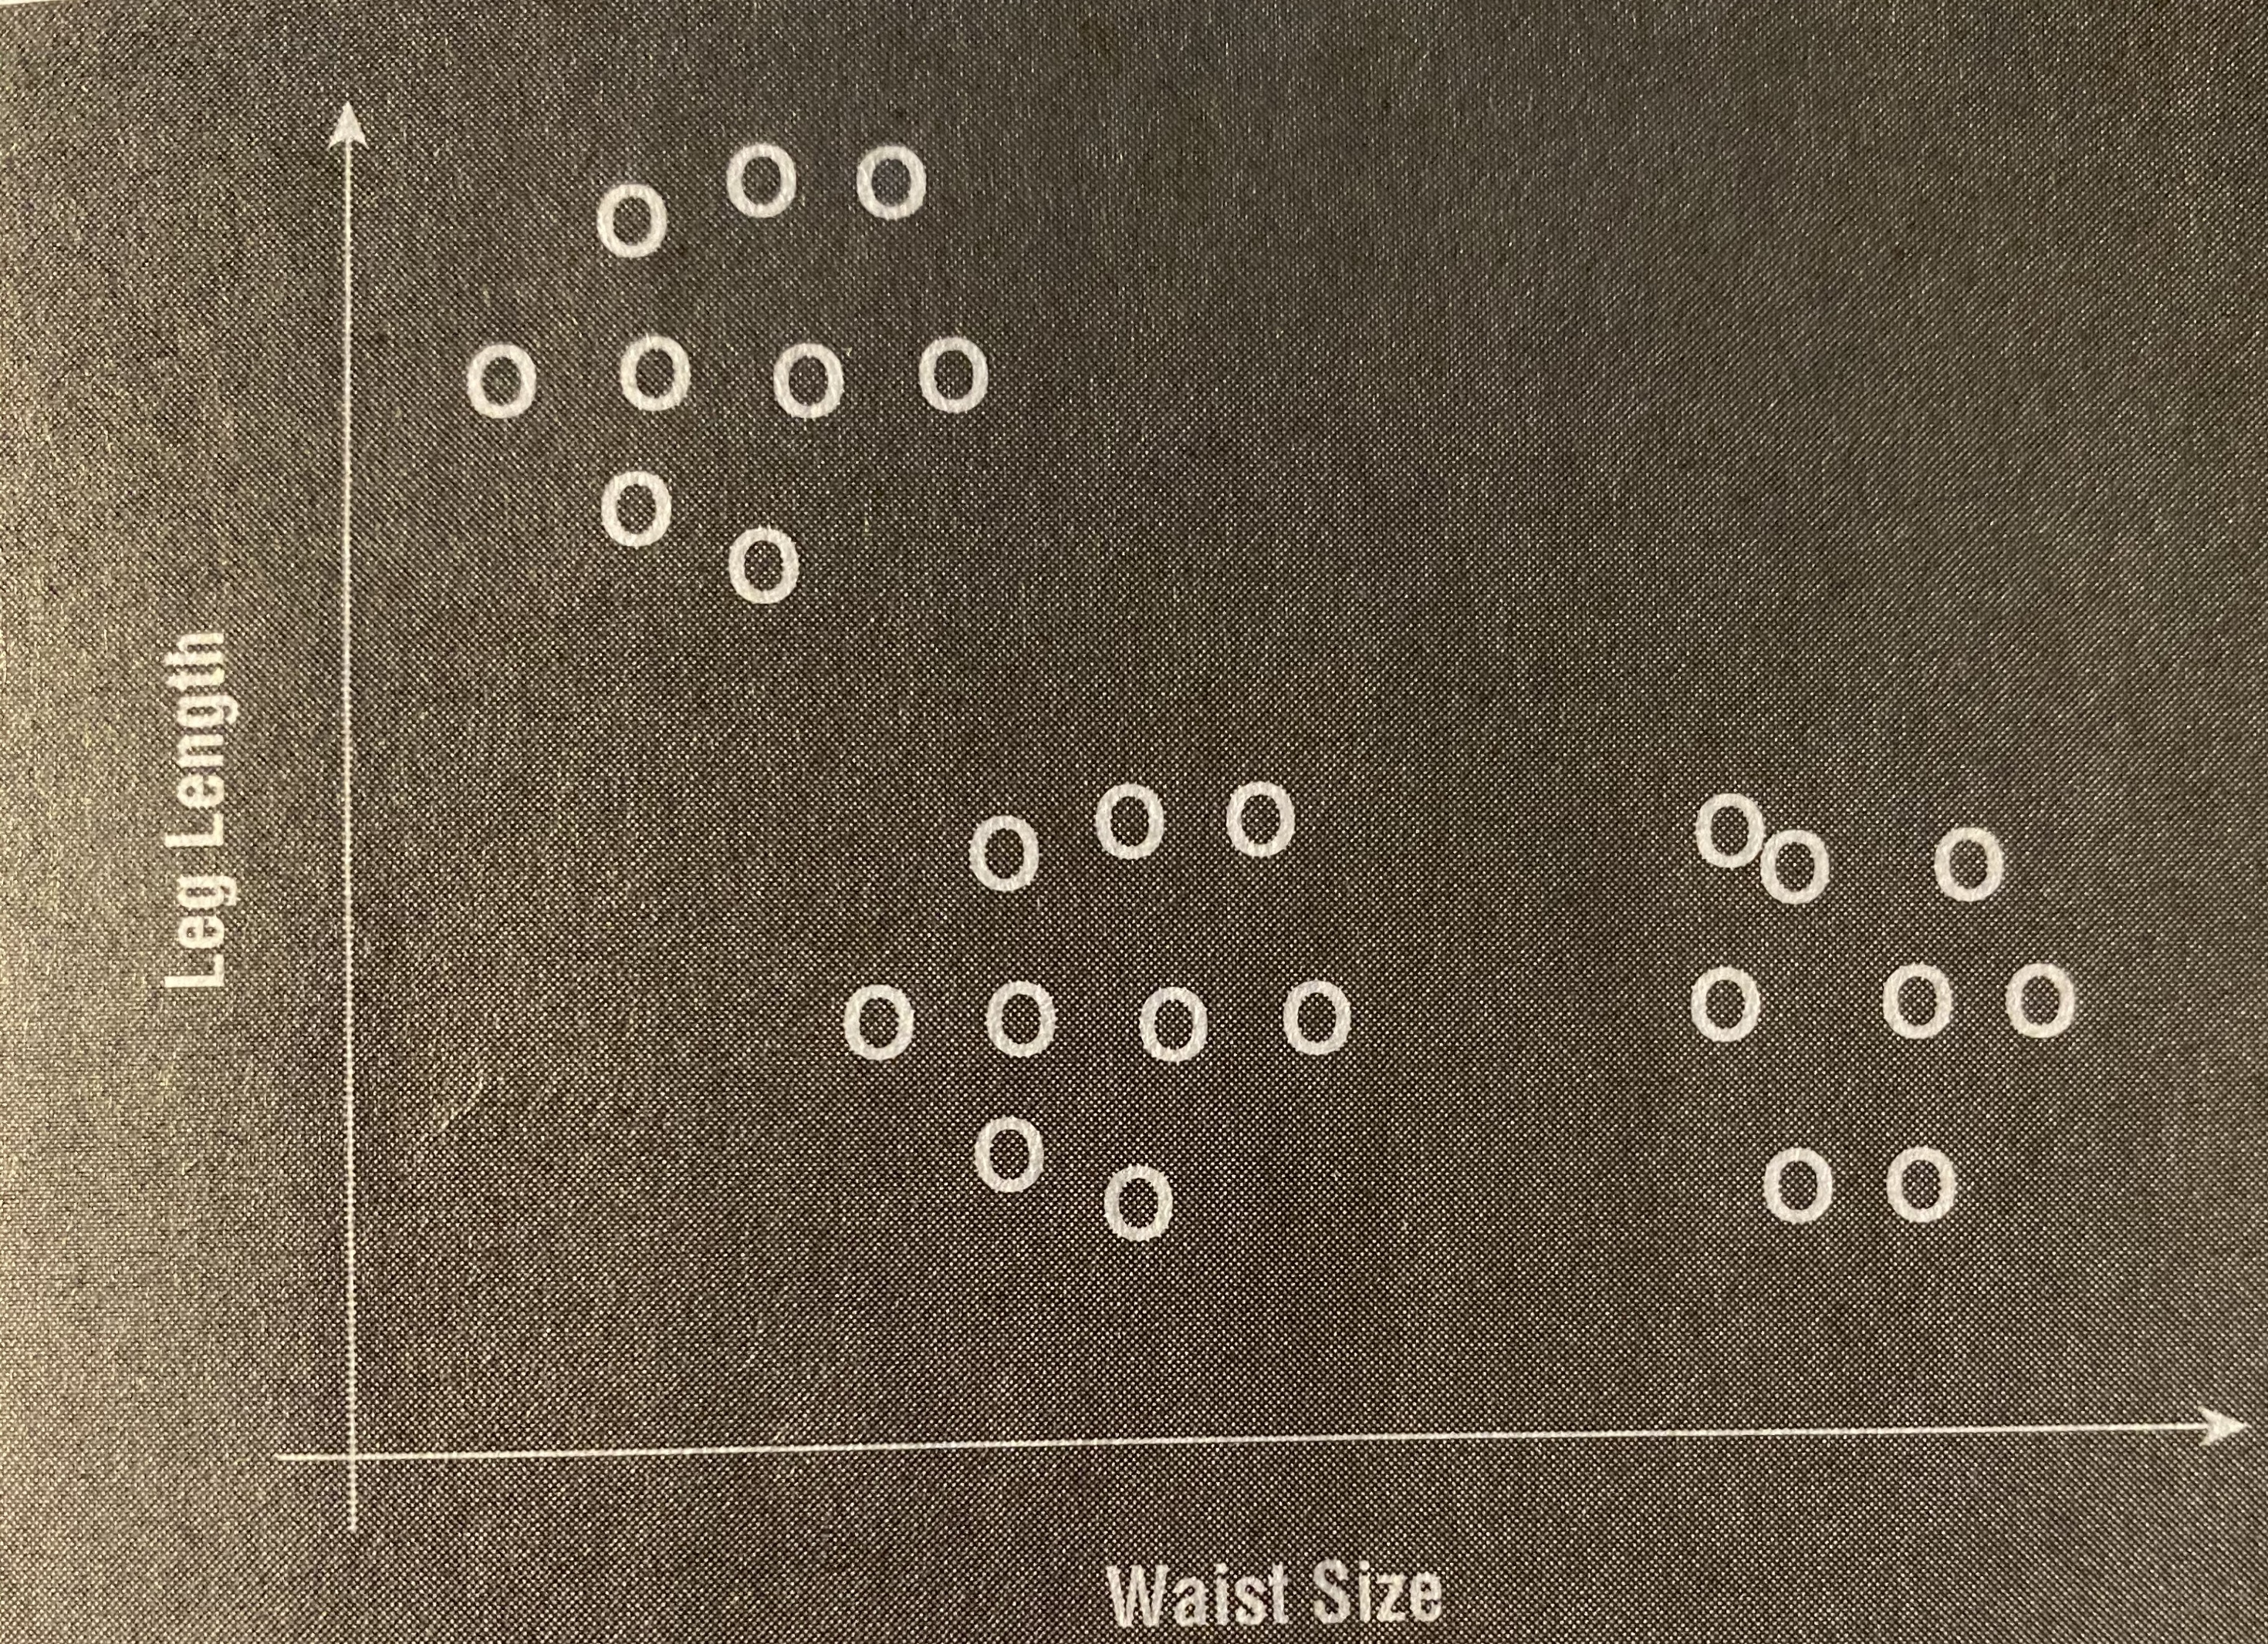
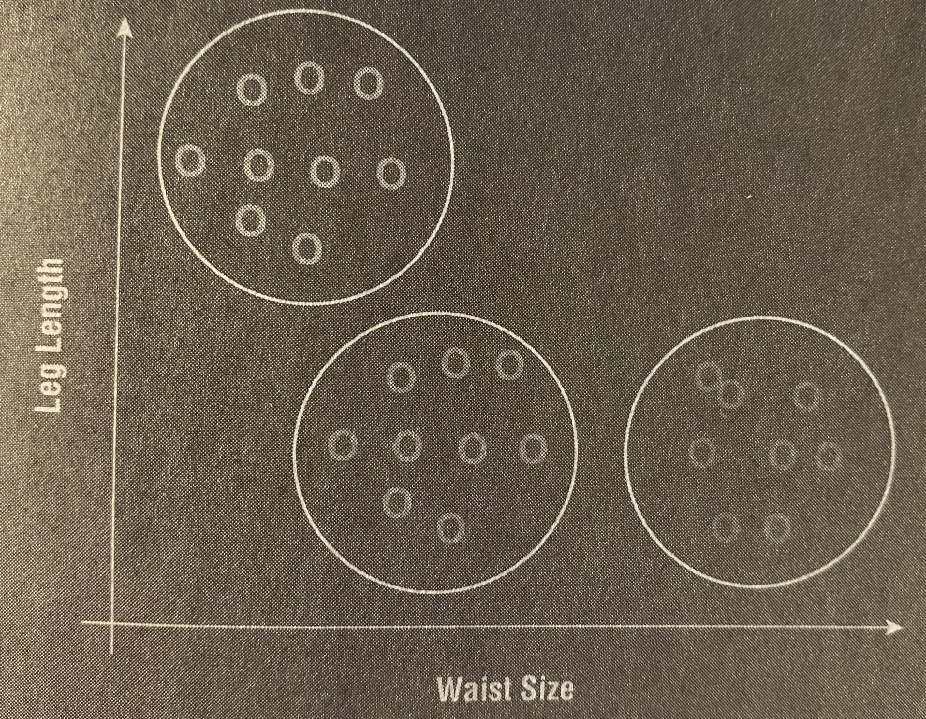
Other Simple examples
Supervised Learning
A dataset may contain records with the size of various houses and the prizes for which they are sold.
House Size, Price Sold (label)
A plotted chart can help you to predict the price of a house that is yet to be sold (this is a regression problem)
Unsupervised Learning
A dataset (not labeled) contains records with the waist and leg length of a group of people
Waist Size, leg length
Try to predict a pattern in the dataset. You can plot a chart.
The result is 3 different distinct groups of clusters in the data.

Slide 45
Break
7:40 pm – 7:50pm
Break
8:40 pm – 8:50 pm
6:30 pm – 7:30 pm
7:50 pm – 8:40 pm
8:50 pm – 9:30 pm
Part 1
Introduction
Part 2
Logistics
Regression (L/Log) using Python
Questions

Slide 46
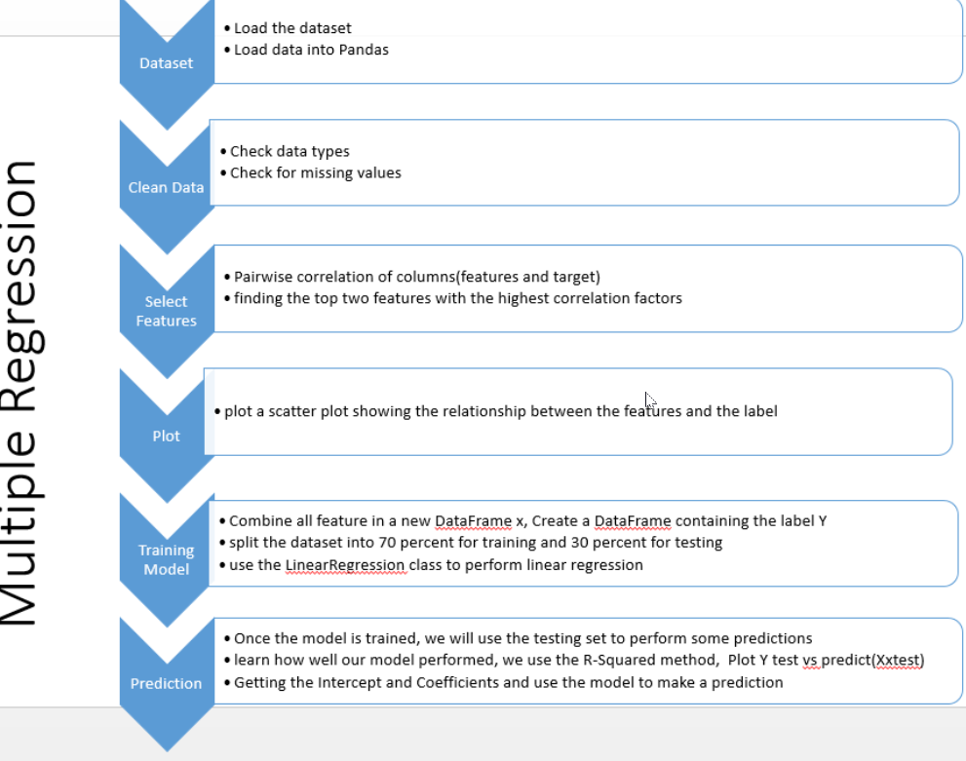

Slide 47
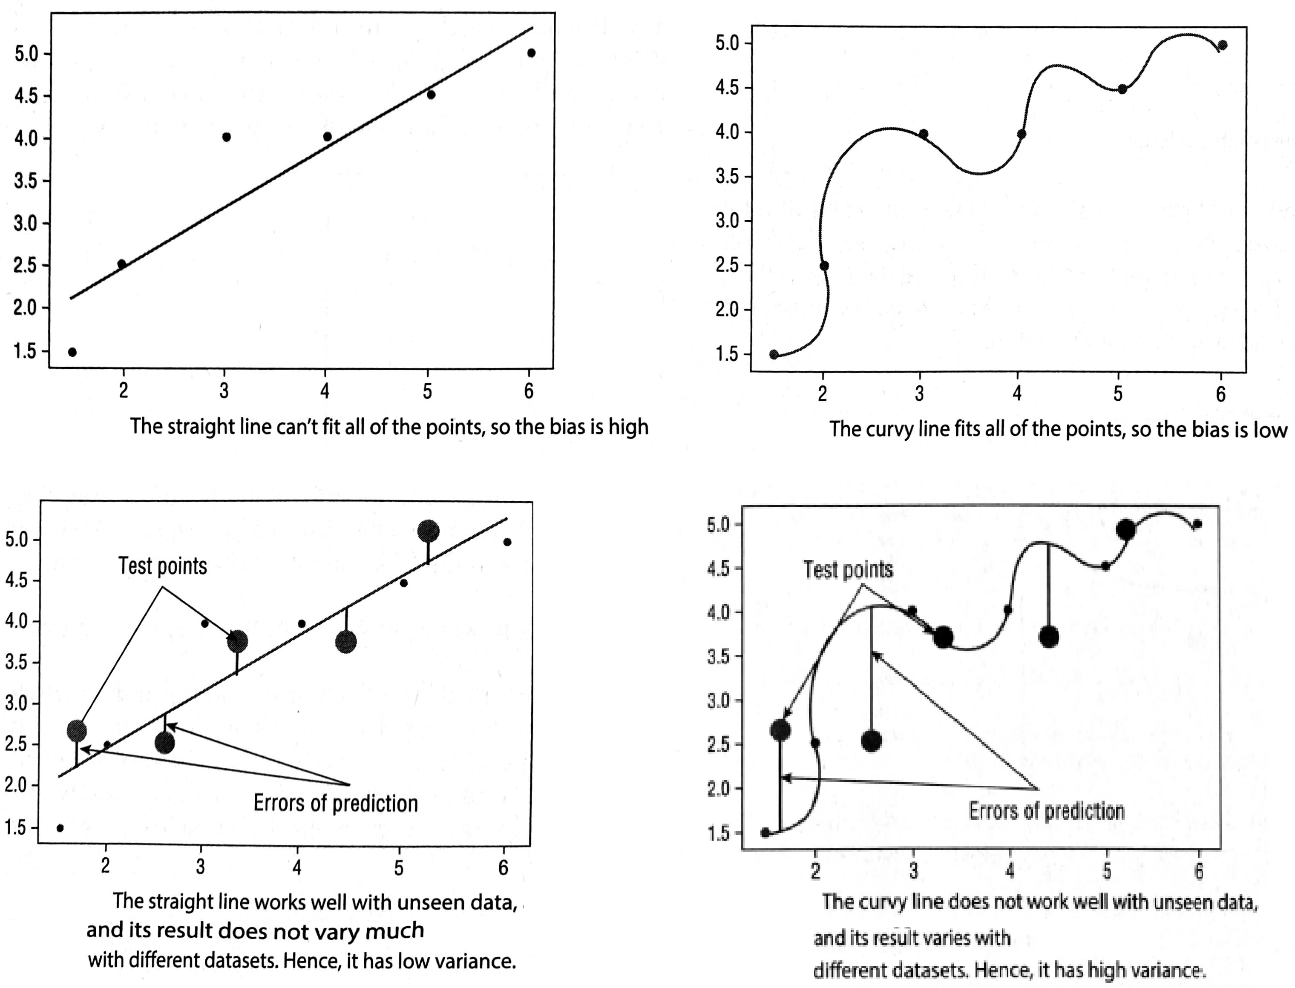
Understanding Bias and Variance
The inability for a machine learning algorithm to capture the true relationship between the variables and the outcome is known as the bias.
While the straight line can’t fit through all of the points and has high bias, when it comes to applying unseen observations, it gives a pretty good estimate. Figure bottom-left shows the testing points (bigger size).
The RSS (Residual Sum of Squares), which is the sum of the errors of prediction, is pretty low compared to that of the curvy line when using the same test points (see Figure bottom-right).
straight line trying to fit all the points. Because it doesn’t cut through all of the points, it has a high bias
The curvy line however, is able to fit all of the points and thus has a low bias.

Slide 48
Overfitting ←----→ Underfitting
Coefficient Of Determination(R²)
It helps to understand which amount of variation in y can be explained by the dependence on x using the particular regression model. The R² value close to 1, the better the fit. It means, the model can better predict the output(y) for the input(x).
Root Mean Square Error(aka Root Mean Square Deviation)
Root Mean Square Error is the standard deviation of the residuals(prediction errors). Residuals are a measure of how far from the regression line data points are. The lower the RMSE value, the model would be fit well.
Overfitting
Simply, it happens when the model learns the existing data too well. Complex models, which have many features, are often prone to overfitting. If the model is overfitted, the R² value would be low when using with new data.
Underfitting
When the model can’t accurately capture the dependencies among data, the underfitting will happen. It often yields a low R² with known data and bad generalization capabilities when applied with new data.

Slide 49
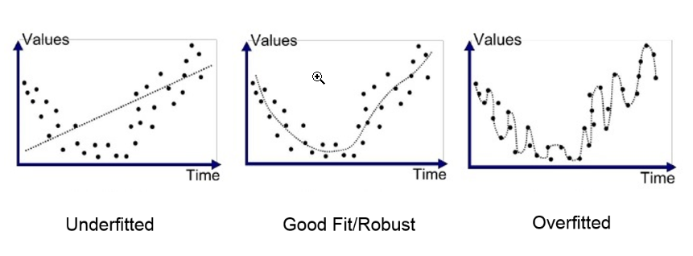

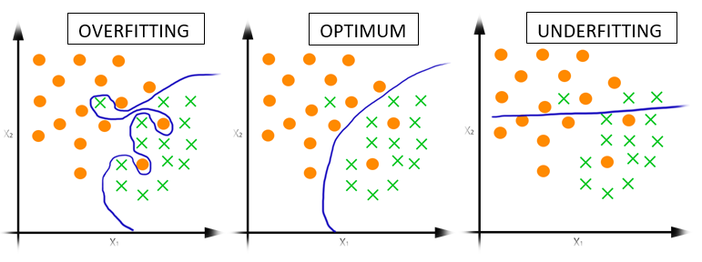
Overfitting
←----→ Underfitting

Slide 50
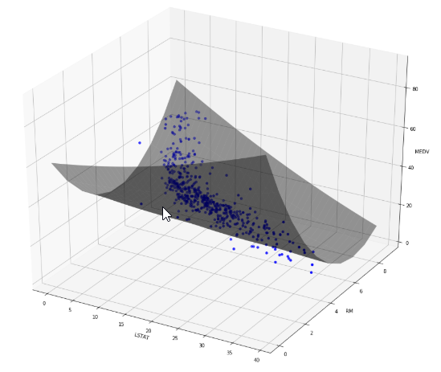
the hyper-plane showing the relationships between two independent variables and the label

Slide 51
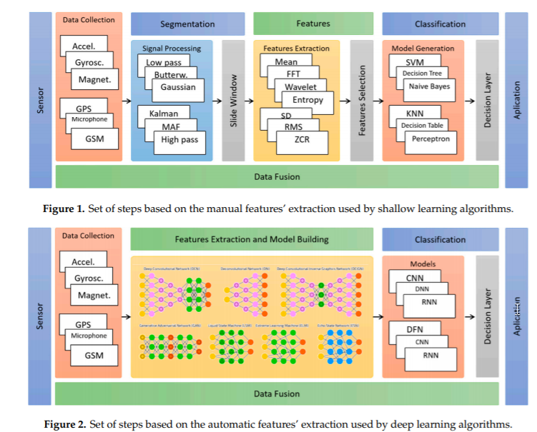

Slide 52
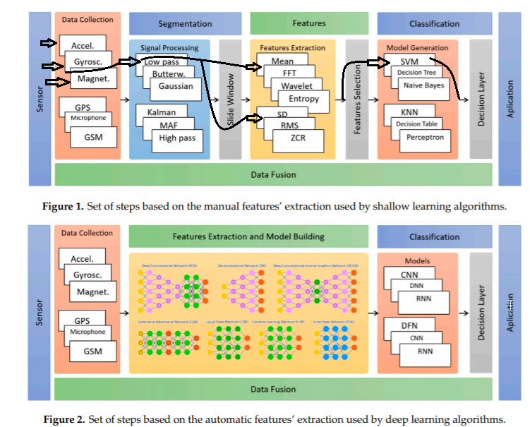
An Example of a machine learning workflow

Slide 53
Human activity recognition
Mobile phones are pervasive, moderately specialized gadgets that have an effective and capable handling power enveloped with smaller segments that can do efficient and powerful calculations. One of the components that is built into the mobile phones to make it more robust are the sensors. Mobile phones are encompassed with several sensors, for example, proximity sensors, temperature sensors, accelerometers, gyroscopes and many more. These sensors have opened up ways to different fields in data mining and data analytics.

Slide 54
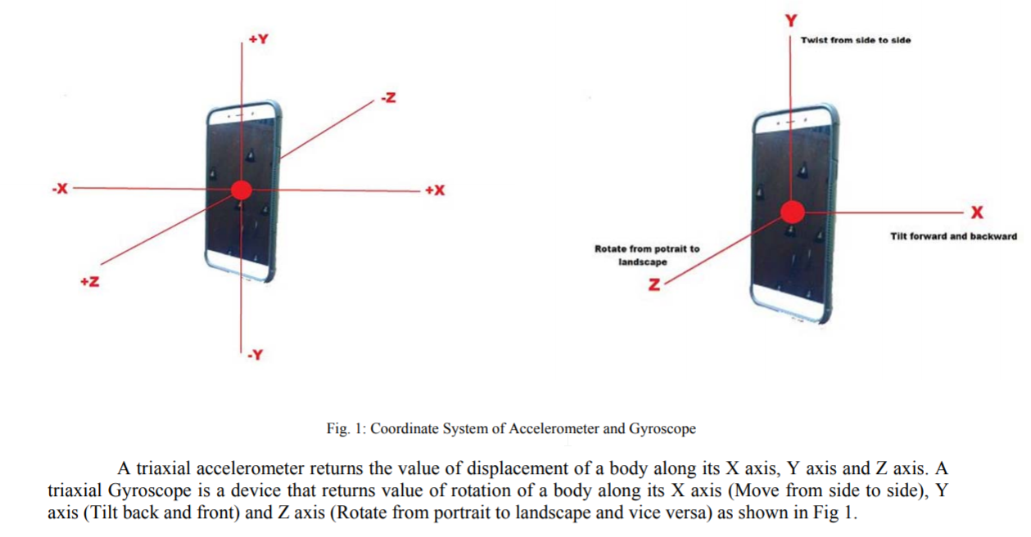

Slide 55
Human activity recognition (HAR) - motivation
The existence of these sensors has empowered people to control its information to perform different tasks. One such task is movement detection which is termed as activity recognition.

Slide 56
The data collection
In this introduction to Human activity recognition (HAR), an existing dataset has been used which consists of 10 volunteers, wearing a pair of accelerometers and gyroscopes close to their right lower arm and a pair of accelerometers and gyroscopes close to their left ankle. The subjects are asked to perform 12 exercises which are standing still, sitting and relaxing, lying down, walking, climbing stairs, waist-bends forward, frontal elevation of arms, knees bending (crouching), cycling, jogging, running, jumping front & back. 11 features were separated for the raw data collected from the sensors.

Slide 57
classification
a novel automated method for classification of human activities, using wearable sensors which are also found interfaced within most of the modern mobile phones, is developed. The features are extracted from the recordings of data from individual as well as combination of sensors. The publicly available dataset is used for experimentation

Slide 58
Activities:
Activities: A1-Standing, A2-Sitting, A3-Lying Down, A4-Walking, A5-Climbing Up, A6-Stepping Down, A7-Sit Ups, A8-Vaccuming, A9- Brushing, A10-Driving, A11-Inactive, A12-Cleaning, A13-Cooking, A14-Medication, A15 Sweeping, A16-Washing Hands, A17-Watering Plants, A18-Tai Chi Movements, A19-Hammering, A20-Screwing, A21-Spanner Using, A22-Power Drill, A23-Martial Arts Movements, A24- Jogging, A25-Running, A26-Cycling, A27-Biking.

Slide 59
Features
Features: MV-Mean value, SD-Standard Deviation, MD-Median, MX-Maximum, MN-Minimum, SMA-Signal Magnitude Area, RMS-Root Mean Square, IR-Interquartile Range, SE-Signal Entropy, AC-Autorregresion Coefficients, CC-Correlation Coefficient, LFC-Largest Frequency Component, WAFS-Frequency Signal Weighted Average, FS-Frequency Signal, S-Skewness, K-Kurtosis, EF-Energy of a Frequency, IAV Interval Angle between two Vectors, AAD-Average Absolute Difference, ARA-Average Resultant Acceleration, TBP-Time Between Peaks, BDBinned Distribution, E-Energy, C-Correlation, MoA-Magnitude of Acceleration, CASC-Cross-axis Signals Correlation, FFT-Fast Fourier Transform, SpE-Spectral Energy, EFFT=Frequency domain Entropy log of FFT,ZCC-Zero-Cross Correlation,V-Variance,P-75% Percentile, FRP-Frequency Range Power, Q-Quartiles, AV-Absolute Value, FE-Frequency Entropy.

Slide 60
. DATASET DESCRIPTION
For predicting the activities, the dataset that is publicly available is utilized [12]. The dataset consists of recordings of body movements of ten volunteers performing 12 activities. Body wearable sensors were used to collect the data. Body wearable sensors are smart electronic devices that can be worn on the body with the help of elastic straps. The data was recorded from the sensors placed on the subject's chest, right lower arm and left ankle. Several sensors were used at different locations which allow to measure the motions at various parts of the body. A pair of accelerometers and gyroscopes are placed on right lower arm and left ankle. The activities are labeled simultaneously for each of the recordings. The activities performed by each of the 10 subjects are Standing still, Sitting and relaxing, lying down, Walking, climbing stairs, Waist bends forward, Frontal elevation of arms, Knees bending (crouching), Cycling, Jogging, Running, Jump front & back. Table II illustrates number of records that have been collected for each of the 10 subjects

Slide 61
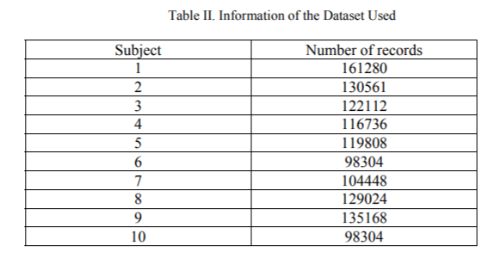

Slide 62
To collect the above data a total of nine sensors have been fixed at different locations. An accelerometer is placed at chest (XYZ), Left ankle (XYZ) and right lower arm (XYZ). A gyroscope is placed at left ankle (XYZ) and right lower arm (XYZ). A magnetometer is placed at left ankle (XYZ) and right lower arm (XYZ) and two electrocardiography sensors to monitor the electrical signals of the heart, resulting in retrieving a total of 23 data for each record. The information in the brackets indicates the number of readings or the axis for the sensor

Slide 63
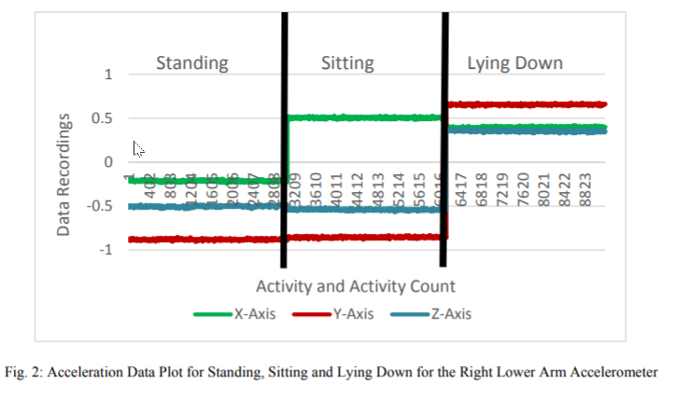
Acceleration Data Plot for Standing, Sitting and Lying Down for the Right Lower Arm Accelerometer

Slide 64
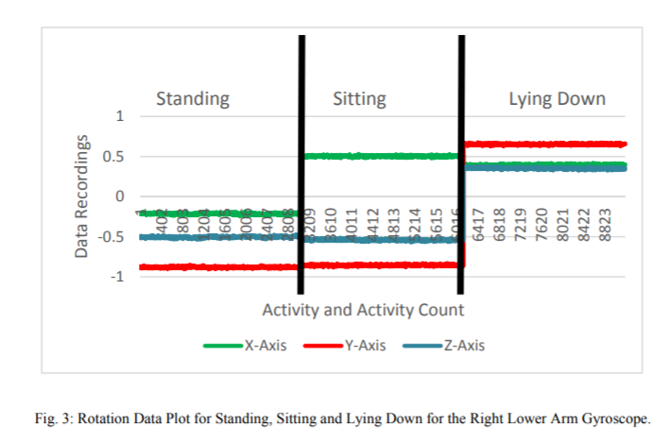
Rotation Data Plot for Standing, Sitting and Lying Down for the Right Lower Arm Gyroscope.

Slide 65
The graphs in Fig. 2 and Fig. 3 show the variations of accelerometer data at different axes for standing, sitting and lying down and gyroscope data at different for the same activities. It is drawn against the 3 axis value on the Y axis and the count of the data on the X axis. In this work, the accelerometer and gyroscope sensors placed at right lower arm and left ankle are considered, because these sensors are embedded into most of the modern mobile phones. Furthermore, static and dynamic activities include drastic movements of the hands and legs

Slide 66
FEATURE EXTRACTION AND SEGMENTATION
The raw data collected from the pair of sensors cannot be applied directly to the machine learning algorithms [13], Hence it is necessary to extract features. Features were extracted from the real time sensor values for every 50 records. The activity with more than 50% overlapping was used to label the window. 50 records are used because it is sufficient to catch various analyses of body motions for each activity. 11 features are extracted on each of the axes of the sensors. Hence for each sensor there were 34 features extracted.

Slide 67
features
The features in use are: • Mean (3): Mean is the Average of set of values. • Median (3): Median is the middle number of set of values after sorting in ascending order • Standard Deviation (3): Standard Deviation measures how spread out the numbers are from the average. • Variance (3): Variance is the average of the squares from the mean. • Min (3): Min is the lowest number • Max (3): Max is the highest number • Kurtosis (3): Kurtosis is the sharpness of the peak of a frequency-distribution curve. • Skewness (3): skewness is a measure of the asymmetry of the probability distribution of a real-valued random variable about its mean. • Interquartile (3): The interquartile range (IQR) is a measure of variability, based on dividing a data set into quartiles. • Percentile 25% (3) and 75% (3): A percentile (or a centile) is a measure used in statistics indicating the value below which a given percentage of observations in a group of observations fall. • Root Mean Square (1): The square root of the arithmetic mean of the squares of all the axis.

Slide 68
The numbers in the brackets indicate the number of features, one for each of the axes of the sensors, and thus total equals to 34 features for every sensor at each location. These features provide meaning to the raw time data collected from sensors when applied through a machine learning algorithms.

Slide 69
IMPLEMENTATION AND RESULTS
The extracted features are subjected to the machine learning algorithm to classify the activities. There are two settings that have been focused on to compare which will deliver the best results. These settings have been used to distinguish between the end outcomes. Setting 1: Single subject is used to train and test the data. 70% of the subject data is used for training and is tested against the remaining 30% on the same subject. Setting 2: Nine subjects are used to train the data and one subject is used to test the data. For both of the settings listed above the studies have been conducted based on three analyses. 1. Analysis for all the sensors used. As discussed in section III, the dataset that is used consists of four sensors placed at two locations. 2. Analysis for pair of sensors (Accelerometer and Gyroscope) collectively placed at two locations. 3. Analysis for combination of same type of sensor collectively.

Slide 70
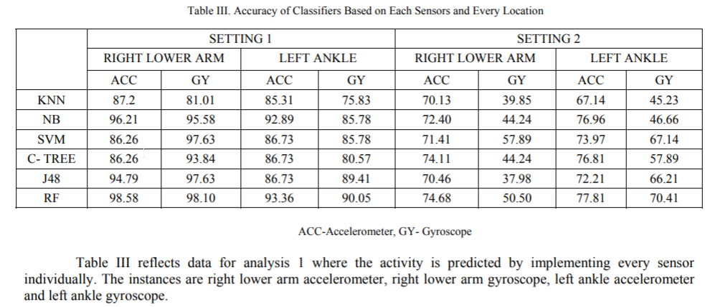
Accuracy of Classifiers Based on Each Sensors and Every Location

Slide 71
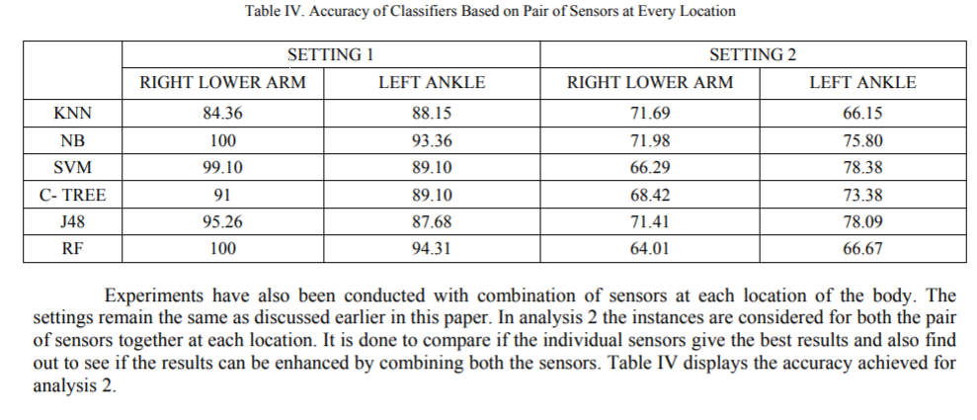
Accuracy of Classifiers Based on Pair of Sensors at Every Location

Slide 72
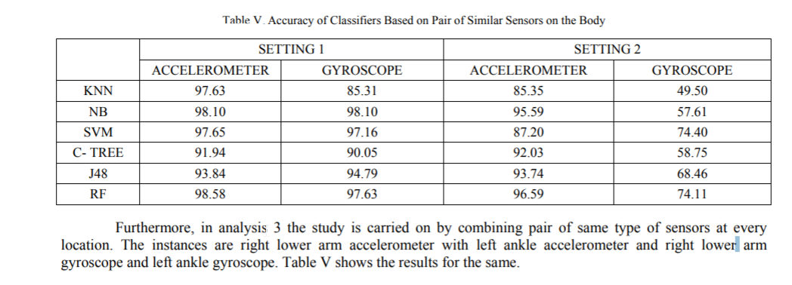
Accuracy of Classifiers Based on Pair of Similar Sensors on the Body

Slide 73
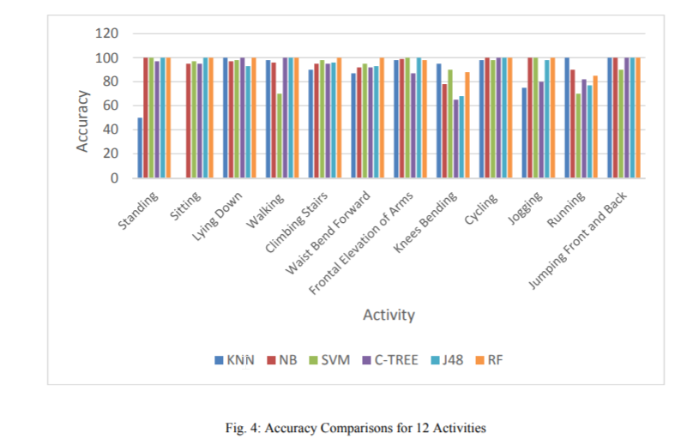
Accuracy Comparisons for 12 Activities

Slide 74
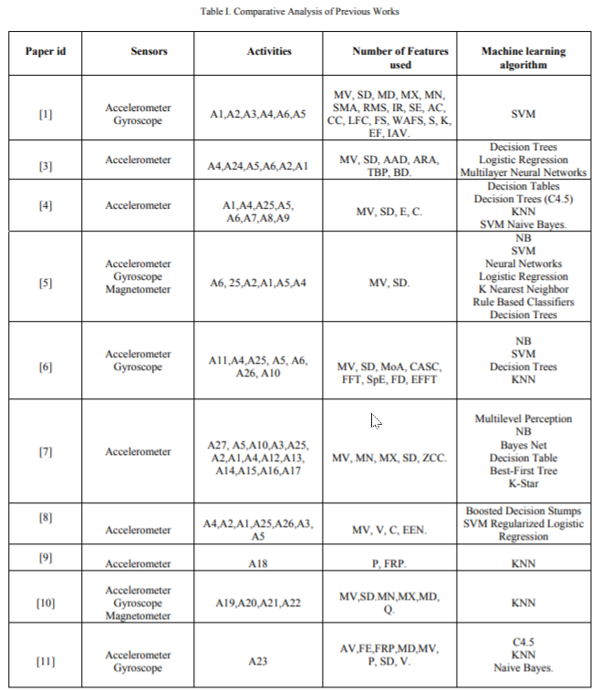

Slide 75
Classification algorithms
The extracted features are classified using six popular classifiers:
K-Nearest Neighbors (KNN),
Naïve Bayes (NB),
Support Vector Machine (SVM),
Conditional Inference Tree (C-Tree),
J48 and Random Forest (RF).
The experimental results are tabulated and analyzed.

Slide 76
conclusion
Activity recognition turns out to be critical in distinguishing and sending fast data about irregular physical body developments of a person.

Slide 77
Students Project Reference Designs
STMicroelectronics SensorTile Reference Design:
Basketball Freethrow Classifier by Machine Learning
Basketball Hookshot Classifier by Machine Learning
Tennis Motion Classifier by Machine Learning
Resistance Training Motion Classifier by Machine Learning
Climb On: A Climbing Motion Classifier by Machine Learning
Shoulder Rehabilitation Motion Classifier by Machine Learning
Reference: https://sites.google.com/view/ucla-stmicroelectronics-iot/home

Slide 78
Part 2 ml algorithms with python jupyter notebooks
June 29, 2020

Slide 79
Getting the tools: anaconda
We will introduce Machine Learning by using the following tools/libraries:
Python
Scikit-learn
Numpy
Pandas
Matplotlib
Anaconda is a free Python distribution that comes with all these libraries, it also includes conda (a package manager), Jupyter Notebook (web-based editor for Python projects), etc.

Slide 80
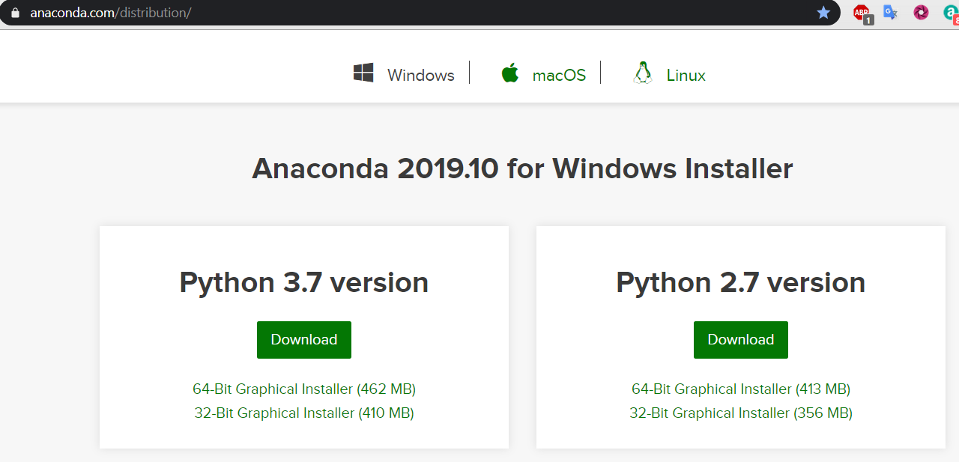
Obtaining anaconda
Download and follow the instructions for installing Anaconda for your OS

Slide 81
Jupyter notebook
Mac
Launch Terminal and type:
Jupyter notebook
Jupyter notebook will start a web server listening at port 8888, after a while, a web browser will launch.
Windows
The best way is to launch it from the Anaconda Prompt.
Anaconda Prompt run the batch file located at: c:\Anaconda3\Scripts\activate.bat
Note that the location could vary:
C:\Users\<username>\AppData\Local\Continuum\anaconda
To launch Anaconda Prompt: type Anaconda Prompt in the Windows Run textbox
To run Jupyter notebook type:
(base) C:\Users\<username>\>jupyter notebook

Slide 82
Jupyter notebook
Creating a jupyter noteboook
Click the New Button
Name the notebook
Running a Cell
To execute, press Ctrl + Enter, or click on the arrow icon to the left of the cell
The order of execution of the cells matters
Adding and Removing Cells
Click the + button, or insert Cell Above/below
Click cut to Remove a Cell
Running a notebook from the beginning:
Click Cell -> Run All
Restarting the Kernel
Because you can execute the cells in any order, the things can get messy. You may want to restart the execution and start all over again
Select: Kernel -> Restart
When your code goes into an infinite loop you need to restart
Exporting your jupyter notebook
Once you are done testing you can export as a python file:
File->Download as -> python (.py extension)
The Python option will download an HTML file

Slide 83
What is numpy?
NumPy is the fundamental package for scientific computing with Python. It contains among other things:
a powerful N-dimensional array object
sophisticated (broadcasting) functions
tools for integrating C/C++ and Fortran code
useful linear algebra, Fourier transform, and random number capabilities
Besides its obvious scientific uses, NumPy can also be used as an efficient multi-dimensional container of generic data. Arbitrary data-types can be defined. This allows NumPy to seamlessly and speedily integrate with a wide variety of databases.
https://numpy.org/

Slide 84
Python list vs ndarray
Python list is a data type to store a collection of items. It is a concept similar to the arrays in C#, Java or JavaScript.
A list in python is as follows:
list1 = [1, 2, 3, 4, 5]
the python list allows to store elements not necessarily of the same type.
list2= [1, “Hello”, 3.14, True, 5]
Python list is more flexible that array, but it has its disadvantages when processing large amounts of data(as is typical of ML projects). Python list problem it is in its efficiency.

Slide 85
Efficiency disadvantage in python list and the solution: numpy
To allow a python list to have non-uniform type items, each item in the list is stored in a memory location, with the list containing an array of pointers to each of these locations. A Python list requires the following:
At least 4 bytes per pointer
At least 16 bytes for the smallest Python object – 4 bytes for a pointer, 4 bytes for the reference count, 4 bytes for the value. All these together round up to 16 bytes.
Due to the way a Python list is implemented, accessing items in a large list is computationally expensive.
To solve this limitation Python programmers turn to Numpy, an extension of Python that adds support for large, multi-dimensional arrays and matrices, along with a large library of high-level mathematical functions to operate with these arrays.

Slide 86
The numpy array: ndarray
In Numpy. An array is of type ndarray (n-dimensional array), and all the elements must be of the same type, and of fixed size, and it is more efficient than the Python list. The ndarray also provides functions that operate on the entire array at once.

Slide 87
Jupyter notebook 1. numpy arrays
Here we will use Jupyter notebook to explore NumPy Arrays and its operations.
Creating NumPy arrays
Array Indexing
Boolean Indexing
Slicing Arrays
Numpy Slice is a Reference
Reshaping Arrays
Array Math
Dot Product
Matrix
Cumulative Sum
Numpy Sorting
Array Assignment
Copying by reference
Copying by View (Shallow copy)
Copying by Value (Deep copy)
File: 01_NumPy.ipynb

Slide 88
Exercises
Print out all the odd number items in the r1 array
Print out the last third number in the r1 array

Slide 89
Solutions
print(r1[r1 % 2 == 1])
print(r1[-3])

Slide 90
What is pandas?
Pandas is Python Data Analysis Library, pandas is an open source, BSD-licensed library providing high-performance, easy-to-use data structures and data analysis tools.
Primary object types:
DataFrame: rows and columns (like a spreadsheet)
Series: a single column
https://medium.com/simple-ai/pandas-library-in-a-nutshell-intro-to-machine-learning-3-acbd39ec5c9c

Slide 91
Getting to Know Your Data
(1) Data analysis helps to make sense of your data, most of the time the datasets don’t come ready to use on Machine learning algorithms and you will find data with some issues to work on as follows:
Illegal values
Misspellings
Missing values (believe me this one of the most common)
Outliers
And there are many others
(2). Data Preparation and Transformations
Data scientist spend a comparatively large amount of time in the data preparation phase of a project. Whether you call it data wrangling, or data janitor work, the Times article estimates 50%-80% of a data scientists’ time is spent on data preparation.
The data transformation process typically consists of multiple steps where each step we try to solve the problems mentioned above. In data transformations we convert a set of data values from the original format into the destination data format (e.g. removing illegal values, imputing missing values, applying a deterministic mathematical function to each point in a dataset, etc).

Slide 92
Jupyter notebook 2. pandas
DataFrame
DataFrame is a 2-dimensional labeled data structure with columns of potentially different types.
You can think of it like a spreadsheet or SQL table, or a dict of Series objects. It is generally the most commonly used pandas object.
Like Series, DataFrame accepts many different kinds of input:
Dict of 1D ndarrays, lists, dicts, or Series
2-D numpy.ndarray
Structured or record ndarray
A Series
Another DataFrame
Along with the data, you can optionally pass index (row labels) and columns (column labels) arguments.
If you pass an index and / or columns, you are guaranteeing the index and / or columns of the resulting DataFrame

Slide 93
What Is matplotlib?
A’ picture is worth a thousand words.” This is probably most true in the world of machine learning. No matter how large or how small your dataset, it is often very useful (and many times, essential) that you are able to visualize the data and see the relationships between the various features within it. For example, given a dataset containing a group of students with their family details (such as examination results, family income, educational background of parents, and so forth), you might want to establish a relationship between the students’ results with their family income. The best way to do this would be to plot a chart displaying the related data. Once the chart is plotted, you can then use it to draw your own conclusions and determine whether the results have a positive relationship to family income.
In Python, one of the most commonly used tools for plotting is matplotlib. Matplotlib is a Python 2D plotting library that you can use to produce publication quality charts and figures. Using matplotlib, complex charts and figures can be generated with ease, and its integration with Jupyter Notebook makes it an ideal tool for machine learning.

Slide 94
Break
7:30 pm – 7:35 pm
Break
9:10 pm – 9:15 pm
Part 1
Introduction
Part 2
Hands-on Activity
Part 3
Office Hours
Questions?
Discussion
Projects + teams
Logistics
6:30 pm – 7:30 pm
7:35 pm – 8:35 pm
9:15 pm – 9:30 pm

Slide 95
Scikit learn, linear regression and logistic regression
Find Python Notebooks

Slide 96
Questions?

